Slide 1
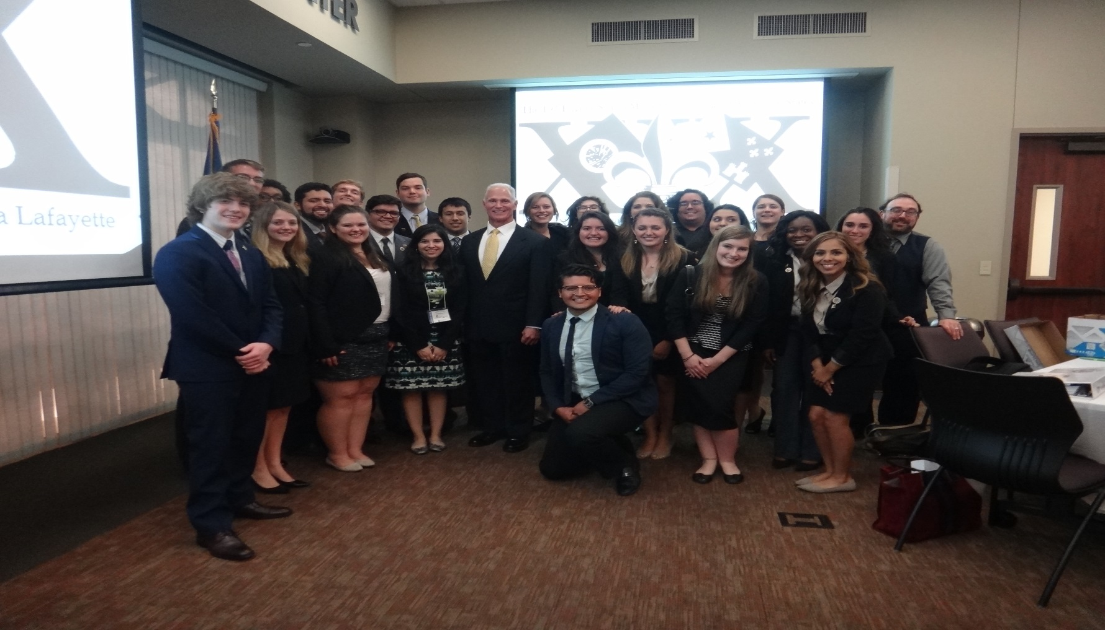
Baylor MOAS Fall 2015

Slide 14
