Slide 1
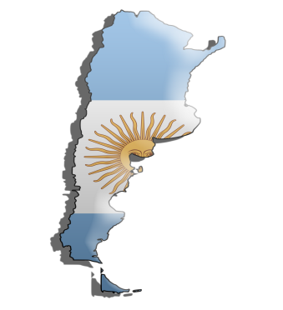
Representing the Argentine Republic
2014 WMOAS TEAM
43rd Washington Model Organization of American States
March 25th-29th , 2014

Slide 2
Leaving Waco for Washington, D.C.

Slide 3
Organization of American States Building
Established April 30, 1948
Formerly the Pan American Union headquarters
Brief History: The Organization of American States is the world’s oldest regional organization, dating back to the First International Conference of American States, held in Washington, D.C., from October 1889 to April 1890.
The OAS came into being in 1948 with the signing in Bogotá, Colombia, of the Charter of the OAS which took effect December 1951.
The Organization uses a four-pronged approach to effectively implement its essential purposes, based on its main pillars: democracy, human rights, security, and development.

Slide 4
Preparing for the 1st day at the OAS Building

Slide 5
First Day of Committee!

Slide 6
Baylor Delegates presenting their resolutions!
Lauren Lee (Sophomore)
Priscilla Escobedo (Senior)

Slide 7
Team Lunch!
Along with daily team meetings, we had the opportunity to discuss our expectations for the Model as well as enjoy each other’s company over some great food!

Slide 8
WMOAS Team at the Argentine Mission to the OAS.

Slide 9
2014 WMOAS President (Senior) Will Gregory passing the gavel to 2015 WMOAS President (Junior) Ewan Hamilton. With a little humor! LOL! ☺

Slide 10
Building Friendships! “The shortest distance between new friends is a smile.” ☺ -Unknown

Slide 11
2014 WMOAS Team after the close of the 43rd WMOAS.
“Happiness does not come from doing easy work but from the afterglow of satisfaction that comes after the achievement of a difficult task that demanded our best.”
- Theodore Rubin

Slide 12
Special Thanks to Dr. Joan Supplee, Ph.D.! We appreciate your dedication, instruction, and time towards making this team the best possible.
The Ralph L. and Bessie Mae Lynn Professor of History

Slide 13
Until Next Time…
44th Washington Model Organization of American States
March 31st- April 4th, 2015

